Slide 1
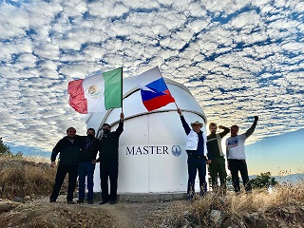
первые успехи в наблюдении источников высоких энергий на телескопе MASTER-OAGH в мексике
Часовников А. Р.
Липунов В. М.
Горбовской Е. С.
Власенко Д. В.

Slide 2
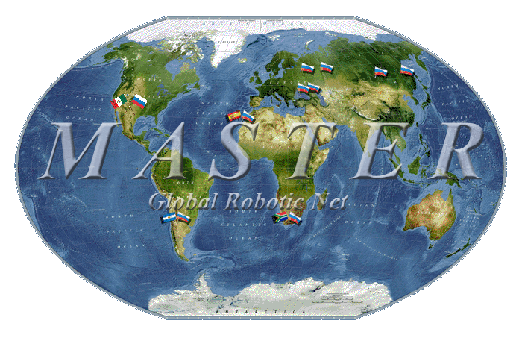

Slide 3
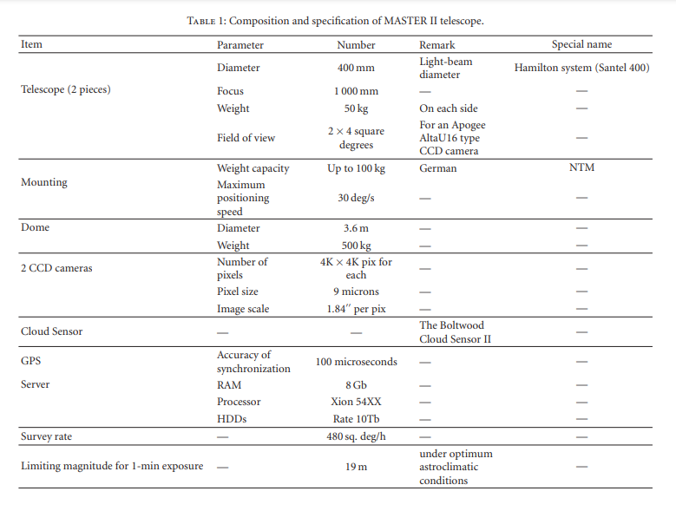

Slide 4
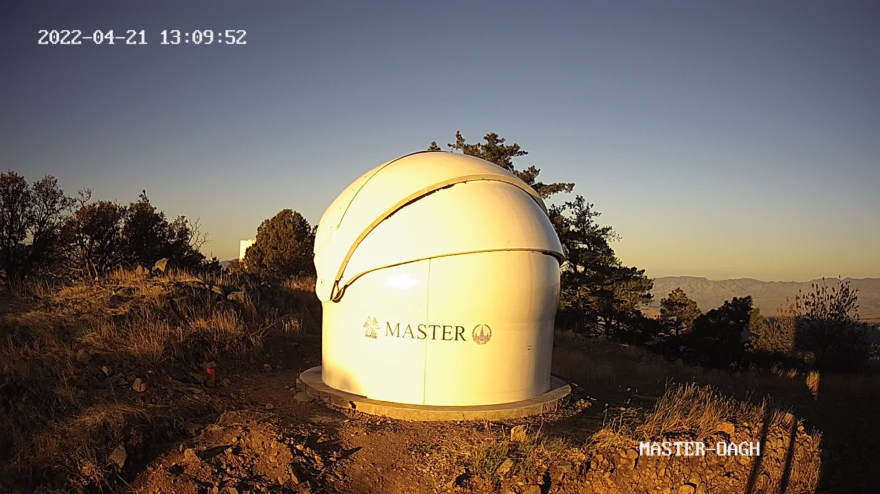

Slide 5
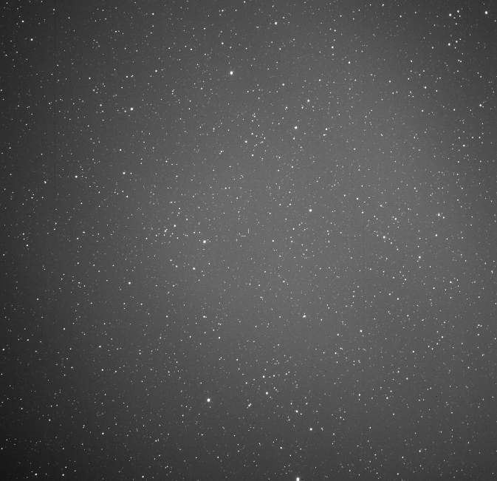

Slide 6
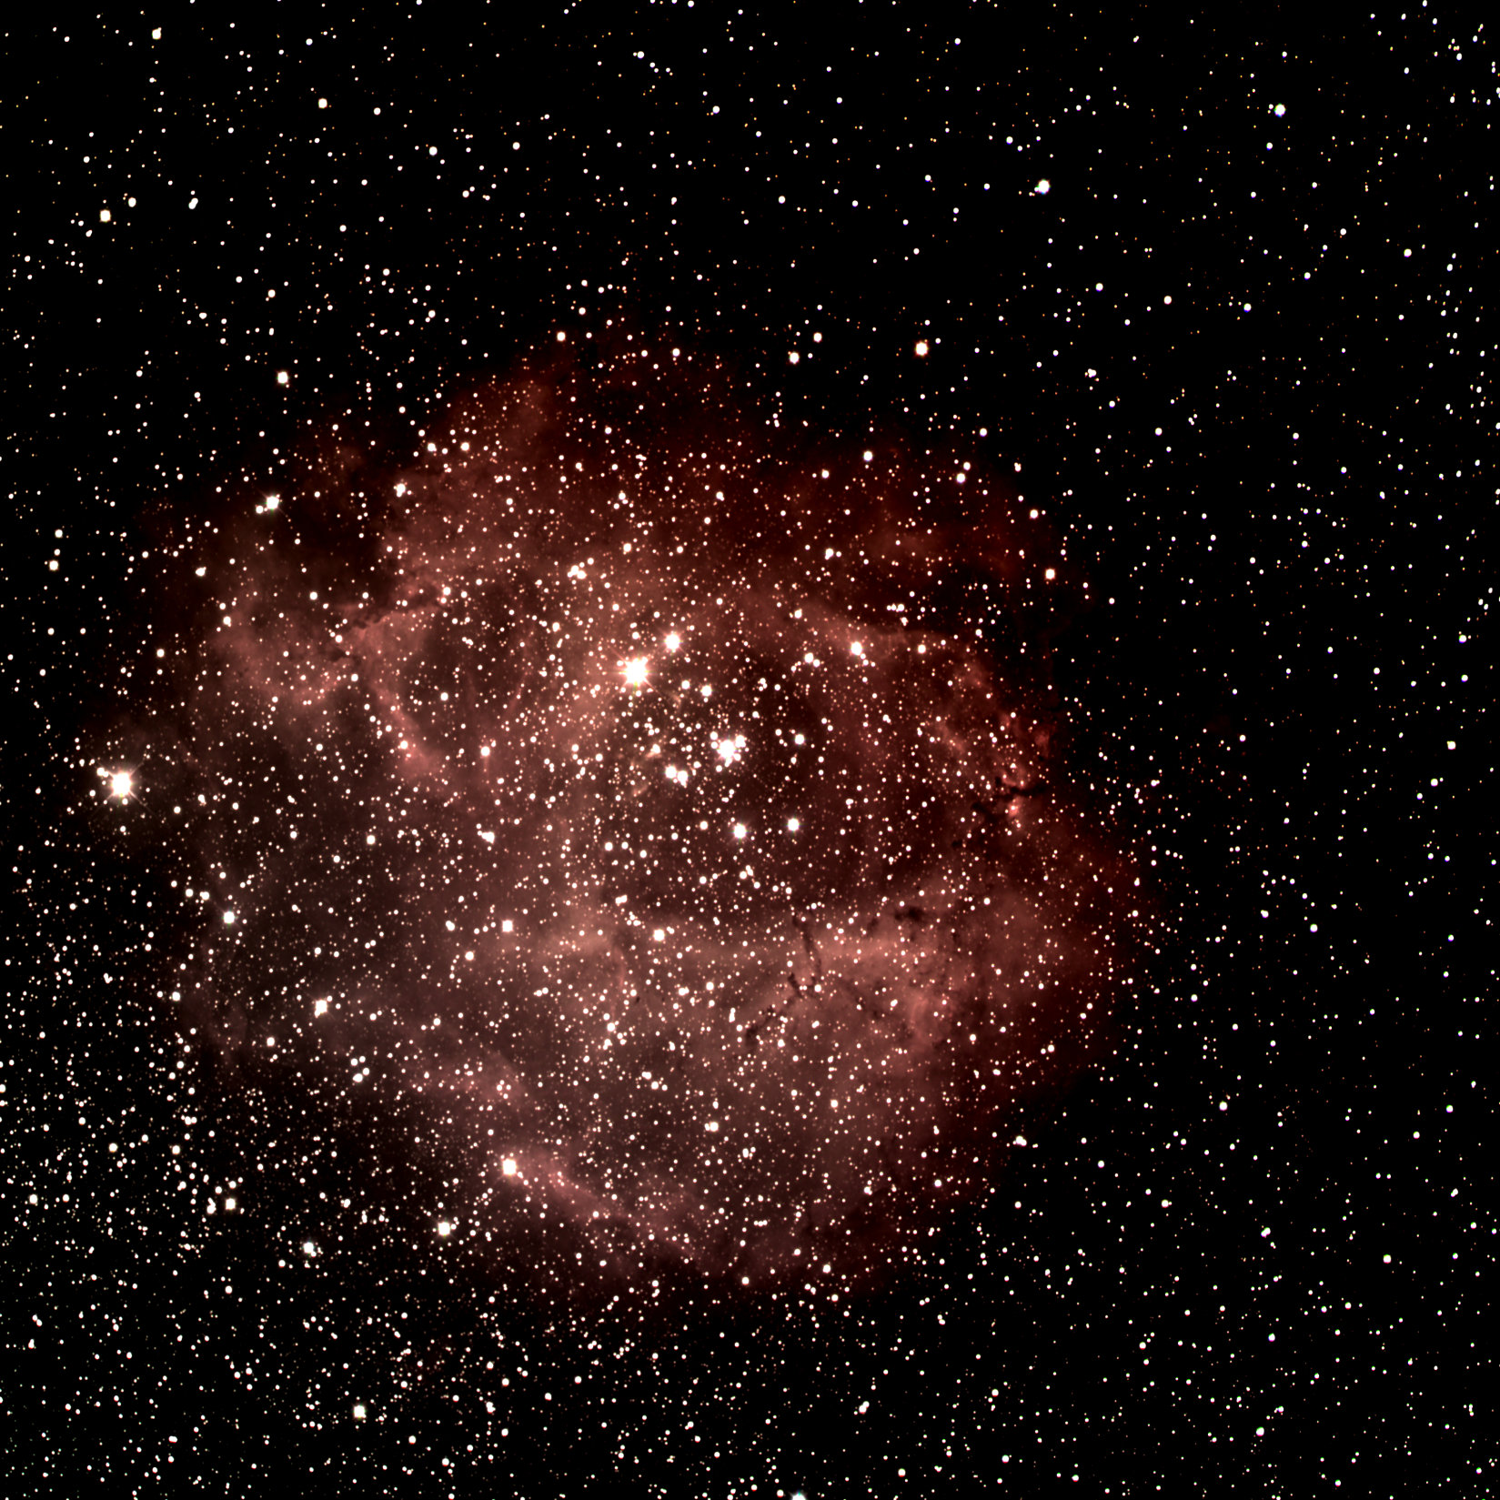

Slide 7
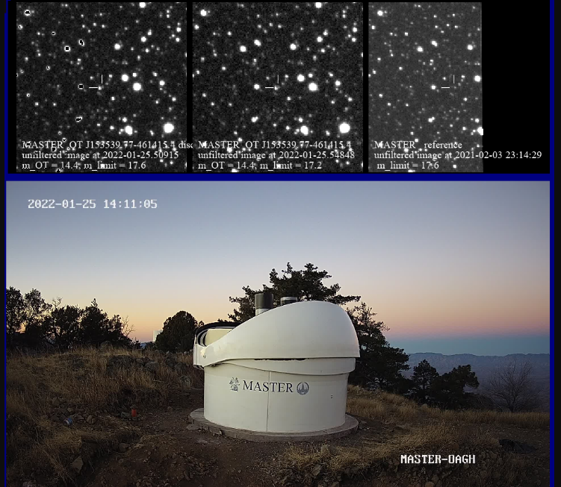
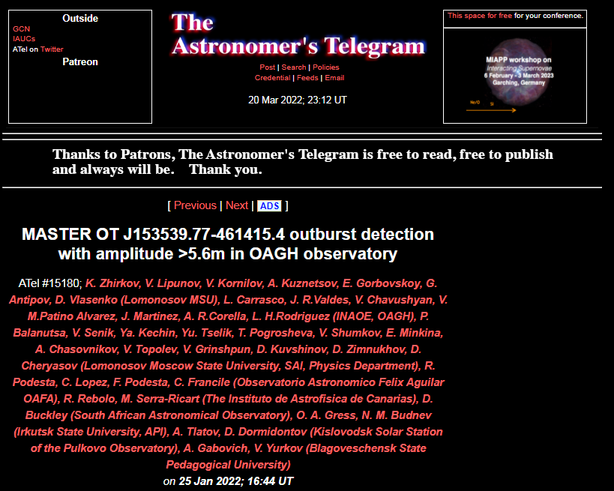
MASTER OT J153539.77-461415.4 outburst detection with amplitude >5.6m in OAGH observatory
https://www.astronomerstelegram.org/?read=15180
MASTER OT J153539.77-461415.4 discovery - dwarf nova outburst with amplitude >5.6m
First optical transient, detected in MASTER-OAGH (INAOE, Mexico).
MASTER-OAGH of Lomonosov MSU MASTER Global Robotic Net
was mounted in December 2021 in Mexico, Guillermo Haro Astrophysics Observatory of the National Institute of Astrophysics, Optics and Electronics.
MASTER-OAGH consists of twin 40cm telescope, equipped with BVRI,PP filters, 4-8 square degrees field of view and has own real-time reduction and auto-detection system (Lipunov et al., MASTER Global Robotic Net, Advances in Astronomy, 2010, 30L).
We use the same scientific equipment at every MASTER observatory, it means the same photometry system and possibility to use own archive images since 2006y. for analysis.
During Fermi trigger 664738369 (Ttrigger=2022-01-24 17:32:44.36UT, R.A.,Dec.(2000)=15h 36m 43s, -46d 38' 23", Rstat=5.08deg.) inspection
MASTER-OAGH auto-detection system discovered OT source at (RA, Dec) = 15h 35m 39.77s -46d 14m 15.4s at 2022-01-25.50915 UT (the second image was at 2022-01-25.54848UT with the same m_OT).
The OT unfiltered magnitude is 14.4m (mlim=17.6).
Taking into account the trigger time this OT should not be connected with GRB optical counterpart.
The OT is seen in 3 images. There is no minor planet at this place.
We have reference images in MASTER archive at 2018-09-12.91464 UT with unfiltered mlim=17.8m, at 2021-02-03 23:14:29UT with unfiltered mlim=17.6, at 2016-07-09 18:19:42UT with mlim=19m .
There is no OT sources in Gaia,USNO inside 4" (22m limit in history). There is VISTA source in 0.7".
Spectral observations are required.

Slide 8
IceCube Alert 220220.60:NuEm-220220A: MASTER optical possible counterpart
MASTER Global Robotic Net (Lipunov et al. 2010, Advances in Astronomy, v.2010, 30L) started IceCube 20220220.60/AMON NuEm-220220A alert (GCN #31615, https://gcn.gsfc.nasa.gov/other/icecube_220220A.gcn3 ) optical observations 25 sec after notice time (618s after trigger time) at 2022-02-20 14:29:55 UT at MASTER-Amur (Lipunov et al. GCN #31616) and observed it in MASTER-OAGH (Mexico), -SAAO (South Africa), -OAFA (Argentina), see cover map https://master.sai.msu.ru/site/master2/event.php?id=1889478 <br> There is a blazar 5BZBJ1442+1200 (RA=220.70117d DEC=12.01119d) 1.5 degrees from the center of the event that shows moderate dimming that started 10 days before the neutrino according to public ATLAS data (https://fallingstar-data.com/forcedphot/queue/169872/plot.pdf).<br> There was IC-201014A in this region (IC GCN #28624, MASTER GCN #28627 ). Due to this dimming we are inclined to believe that 5BZBJ1442+1200 might be a source of NuEM-220220A even though it is largely outside the error-box.
https://gcn.gsfc.nasa.gov/gcn3/31620.gcn3
https://www.astronomerstelegram.org/?read=15231

Slide 9
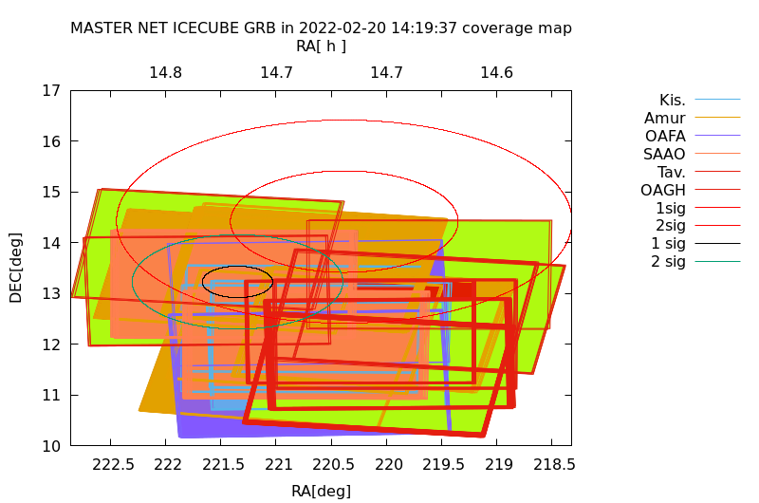
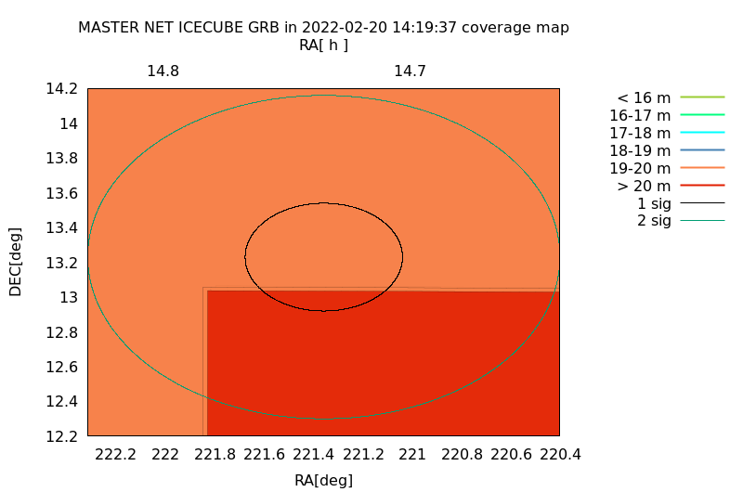
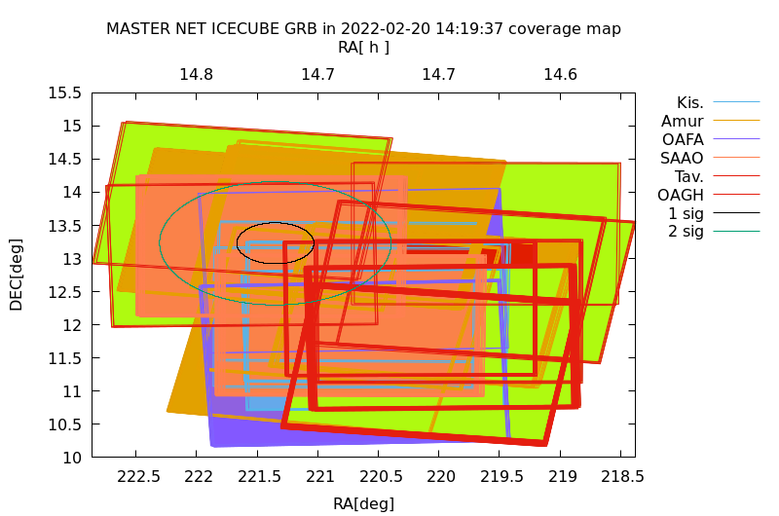
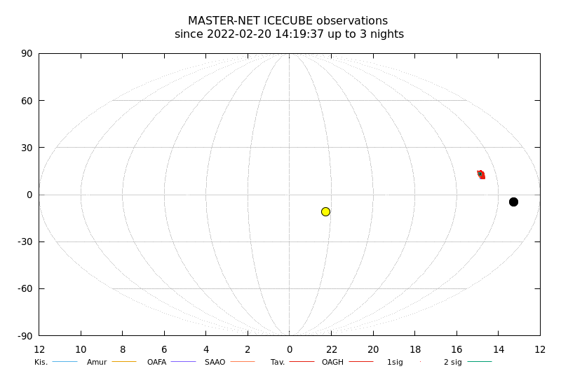

Slide 10
GRB 220211A: MASTER optical observations of ZTF22aaajecp/AT2022cmc
MASTER Global robotic net (MASTER-Net:http://observ.pereplet.ru Lipunov et al.,2010,Advances in Astronomy,2010,30L) started inspect of Fermi short GRB 200211A (Ttrigger=2022-02-11 01:07:48UT, GCN 31570 https://gcn.gsfc.nasa.gov/other/220211A.gcn3) 33 sec after notice time (64 sec after trigger time) at 2022-02-11 01:08:53 UT and observed it at MASTER-IAC, -Tavrida, -Amur, -Kislovodsk, -SAAO, -OAGH, see cover map in Lipunov et al. GCN 31571 https://master.sai.msu.ru/site/master2/observ.php?id=1878703 ) ZTF (Andreoni et al. GCN31590) discovered new OT at R.A.,Dec.=13:34:43.20,+33:13:00.44 (ZTF22aaajecp/AT2022cmc) on 2022-02-11 10:42 UT We are analyzing 1864 MASTER database images of these coordinates since 2006y up to now. Preliminary results of OT detections (unfiltered,calibrated by Gaia) are the following: Date, m_OT 2022-02-13.03UT 19.4 2017-11-14.85UT 17.8 2014-03-27.68UT 19.0
https://gcn.gsfc.nasa.gov/gcn3/31600.gcn3

Slide 11
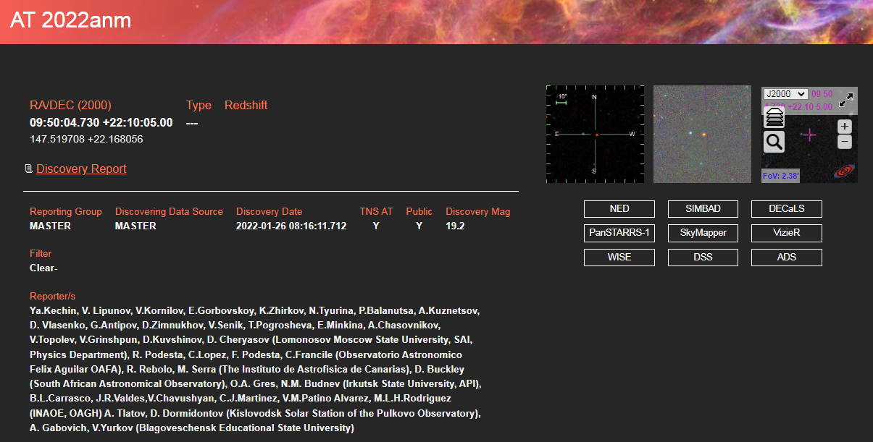
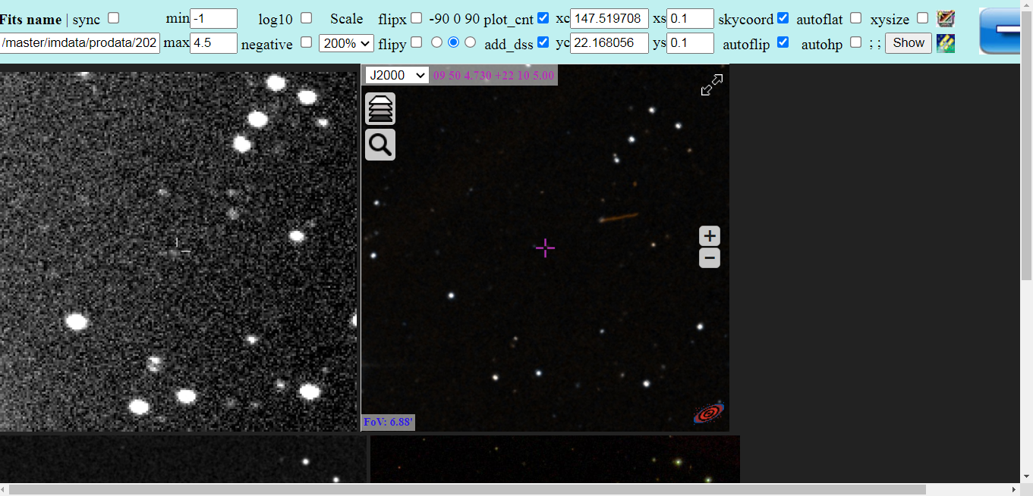
AT 2022anm
https://www.wis-tns.org/object/2022anm/discovery-cert
RA/DEC (2000) 09:50:04.730 +22:10:05.00

Slide 12
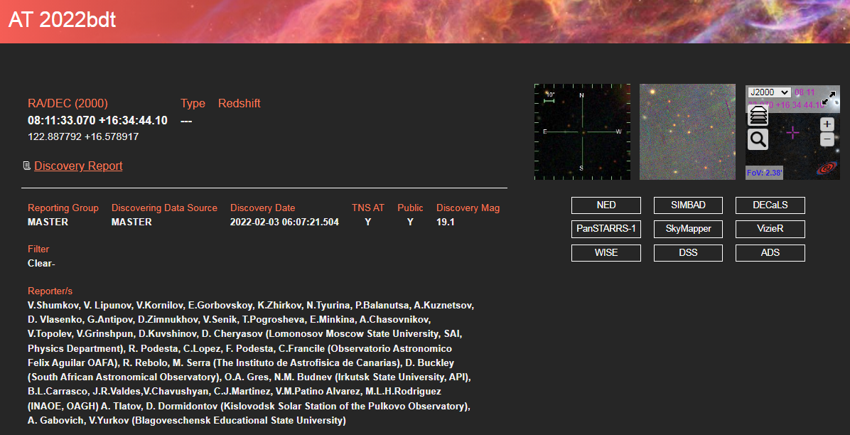
AT 2022bdt
https://www.wis-tns.org/object/2022bdt
RA/DEC (2000)08:11:33.070 +16:34:44.10

Slide 13
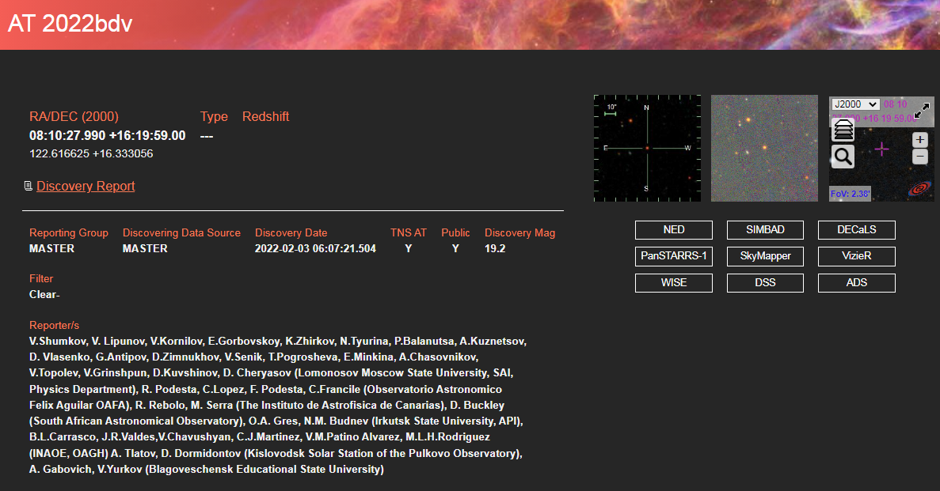
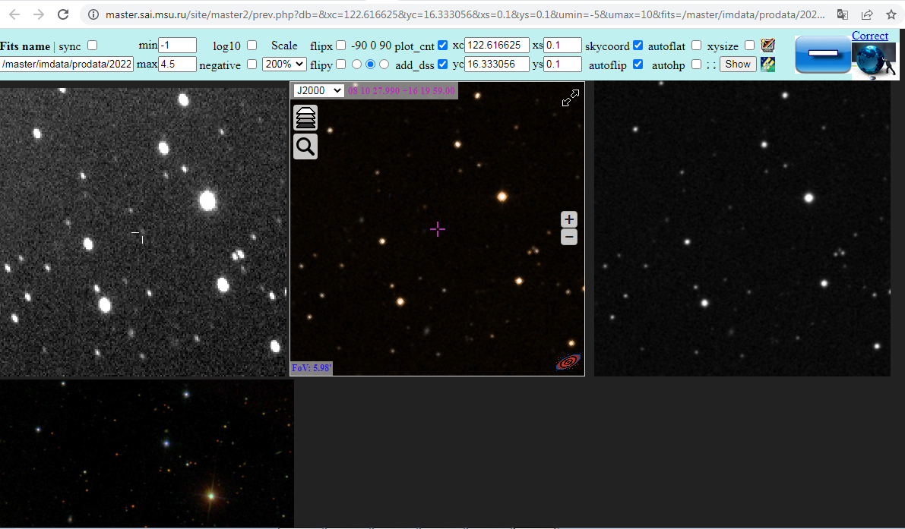
AT 2022bdv
RA/DEC (2000)08:10:27.990 +16:19:59.00
https://www.wis-tns.org/object/2022bdv

Slide 14
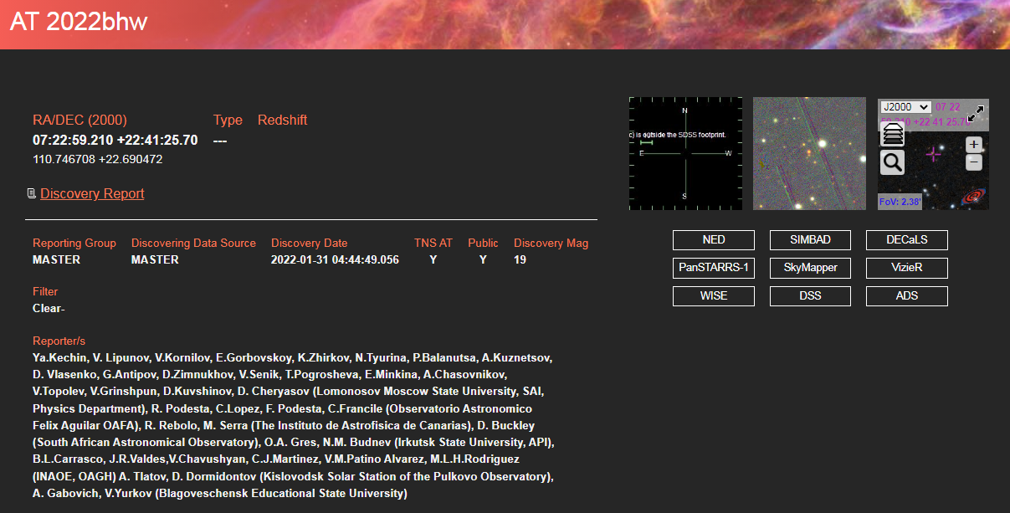
AT 2022bhw
https://www.wis-tns.org/object/2022bhw
RA/DEC (2000)07:22:59.210 +22:41:25.70

Slide 15
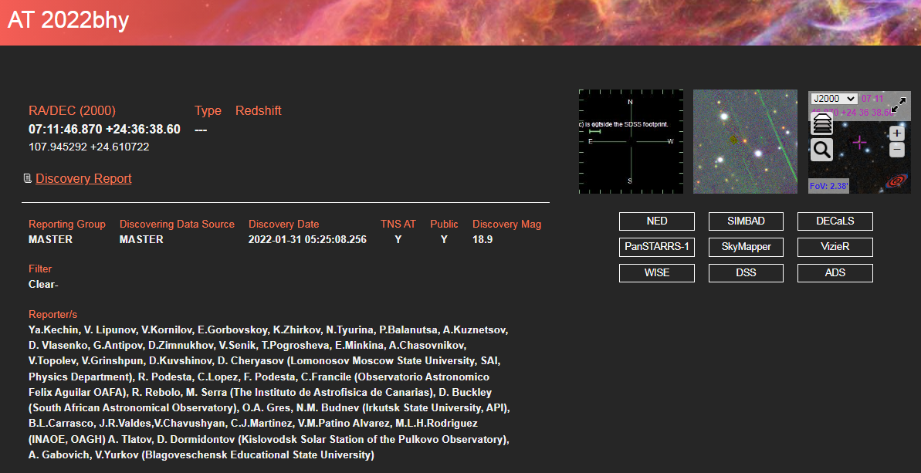
AT 2022bhy
https://www.wis-tns.org/object/2022bhy
RA/DEC (2000)07:11:46.870 +24:36:38.60

Slide 16
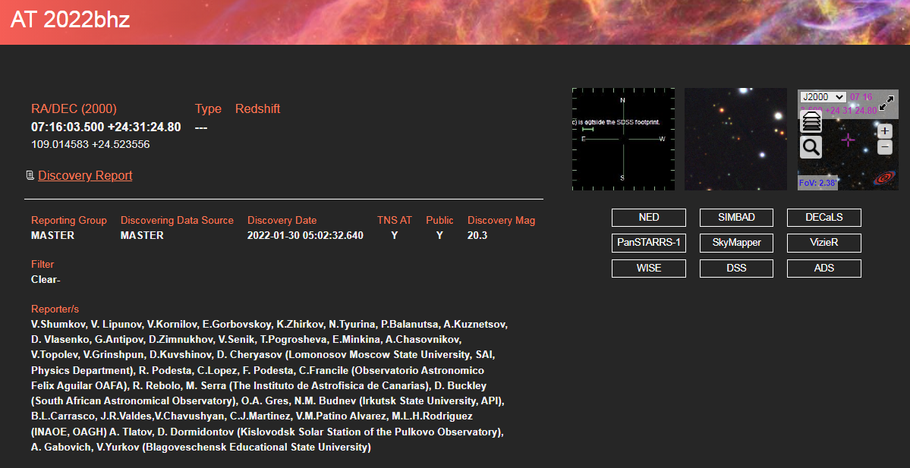
AT 2022bhz
https://www.wis-tns.org/object/2022bhz
RA/DEC (2000)07:16:03.500 +24:31:24.80

Slide 17
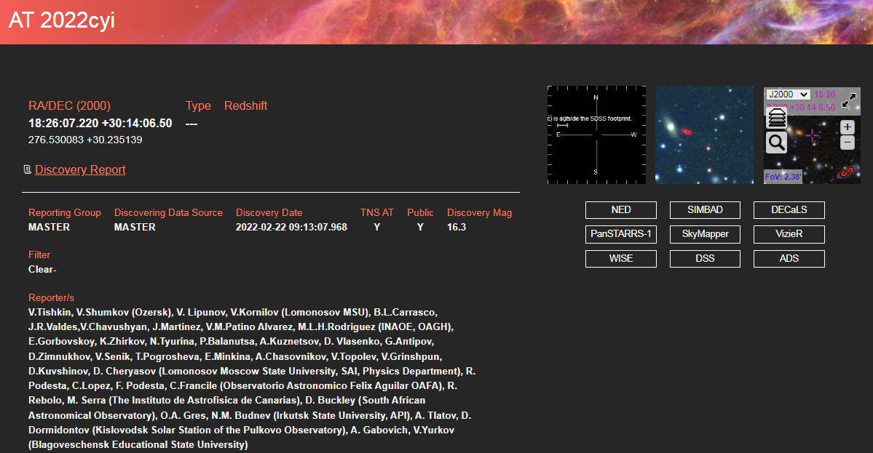
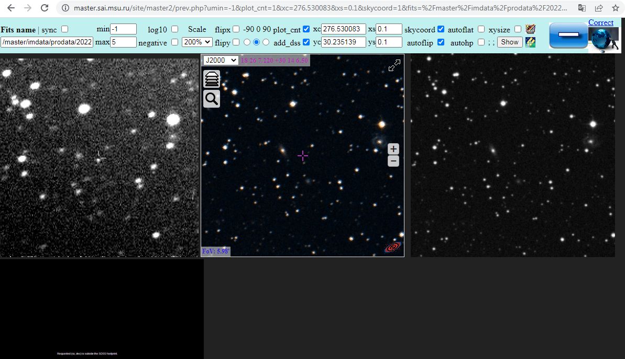
AT 2022cyi
https://www.wis-tns.org/object/2022cyi
RA/DEC (2000)18:26:07.220 +30:14:06.50

Slide 18
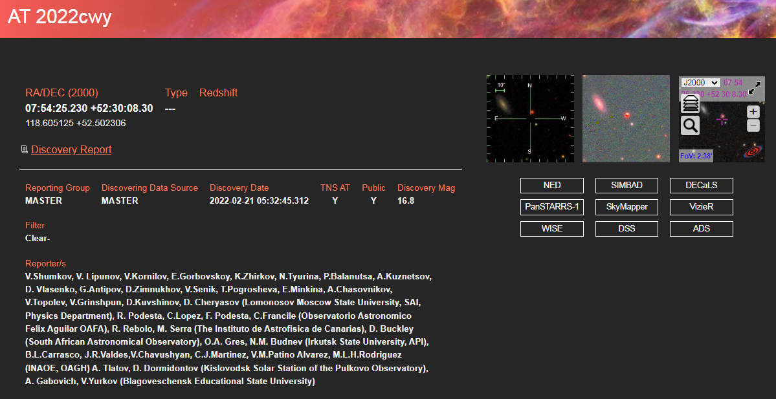
AT 2022cwy
https://www.wis-tns.org/object/2022cwy
RA/DEC (2000)07:54:25.230 +52:30:08.30

Slide 19
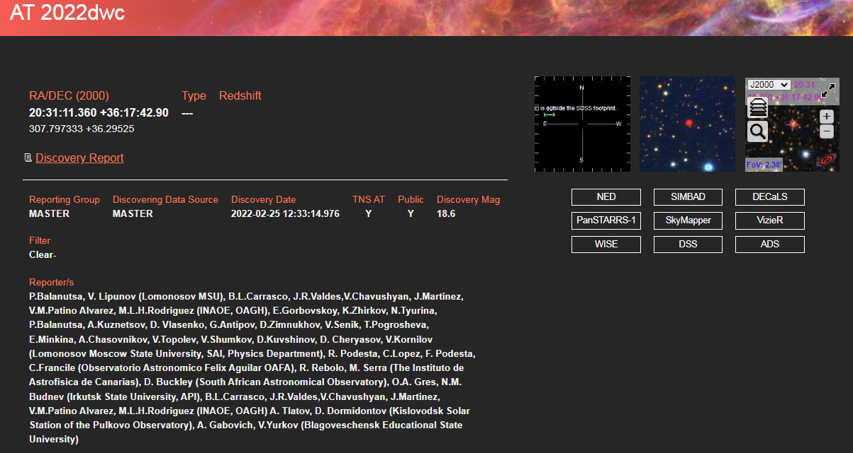
AT 2022dwc
https://www.wis-tns.org/object/2022dwc
RA/DEC (2000)20:31:11.360 +36:17:42.90

Slide 20
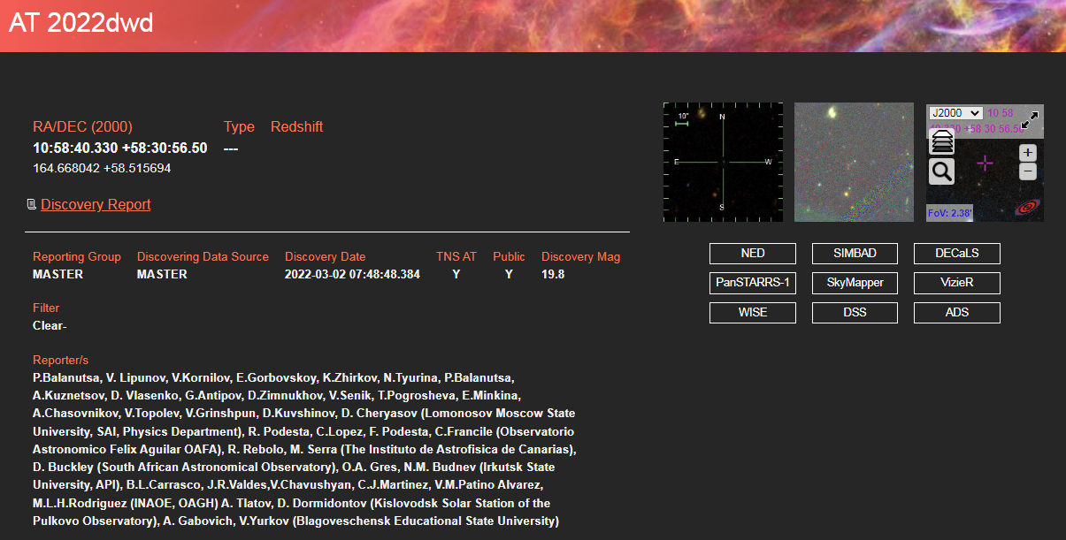
AT 2022dwd
https://www.wis-tns.org/object/2022dwd
RA/DEC (2000)10:58:40.330 +58:30:56.50

Slide 21
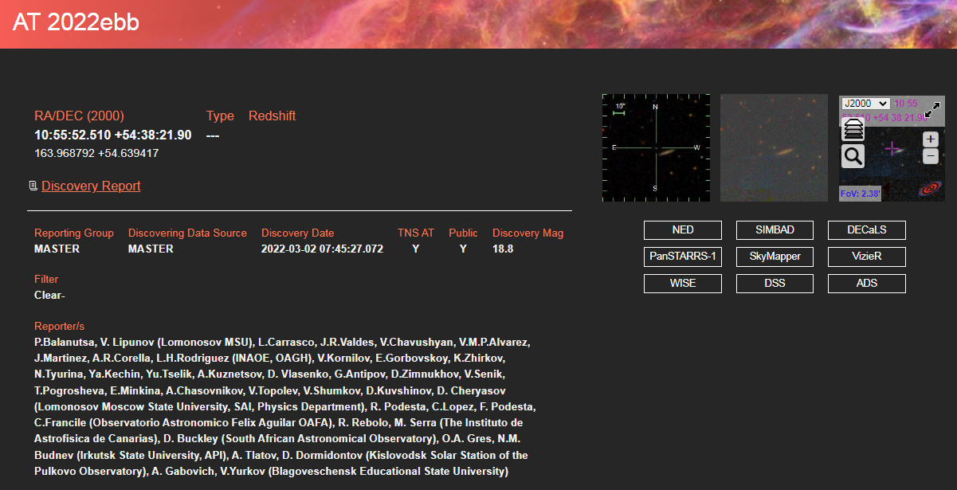
AT 2022ebb
https://www.wis-tns.org/object/2022ebb
RA/DEC (2000)10:55:52.510 +54:38:21.90

Slide 22
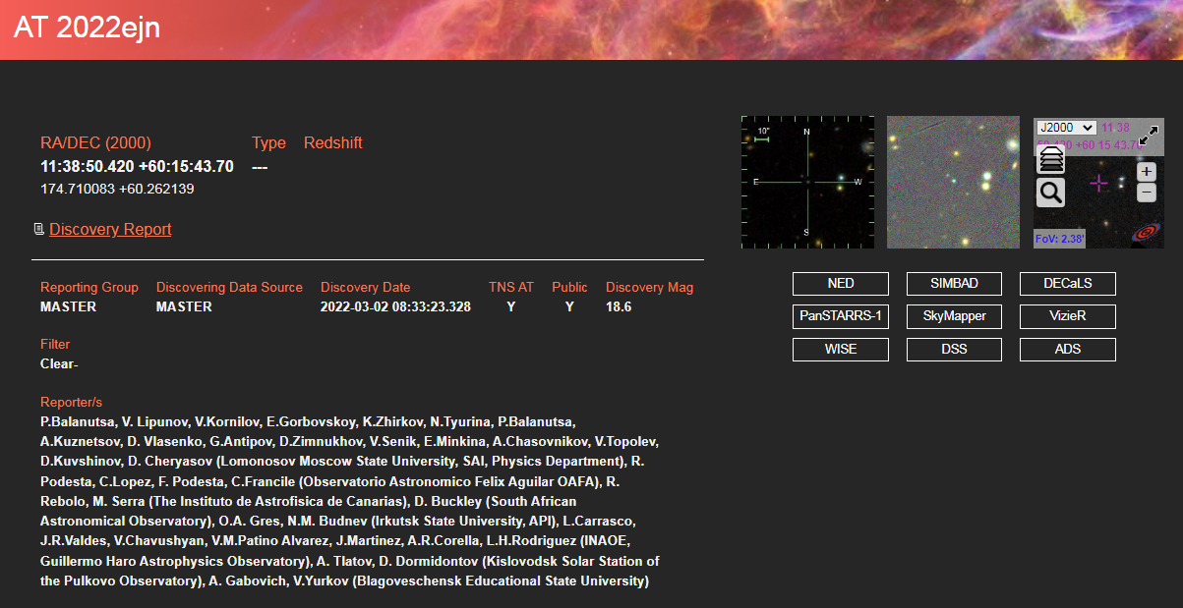
AT 2022ejn
https://www.wis-tns.org/object/2022ejn
RA/DEC (2000)11:38:50.420 +60:15:43.70

Slide 23

AT 2022epv
https://www.wis-tns.org/object/2022epv
RA/DEC (2000)20:30:49.390 +36:57:46.20

Slide 24
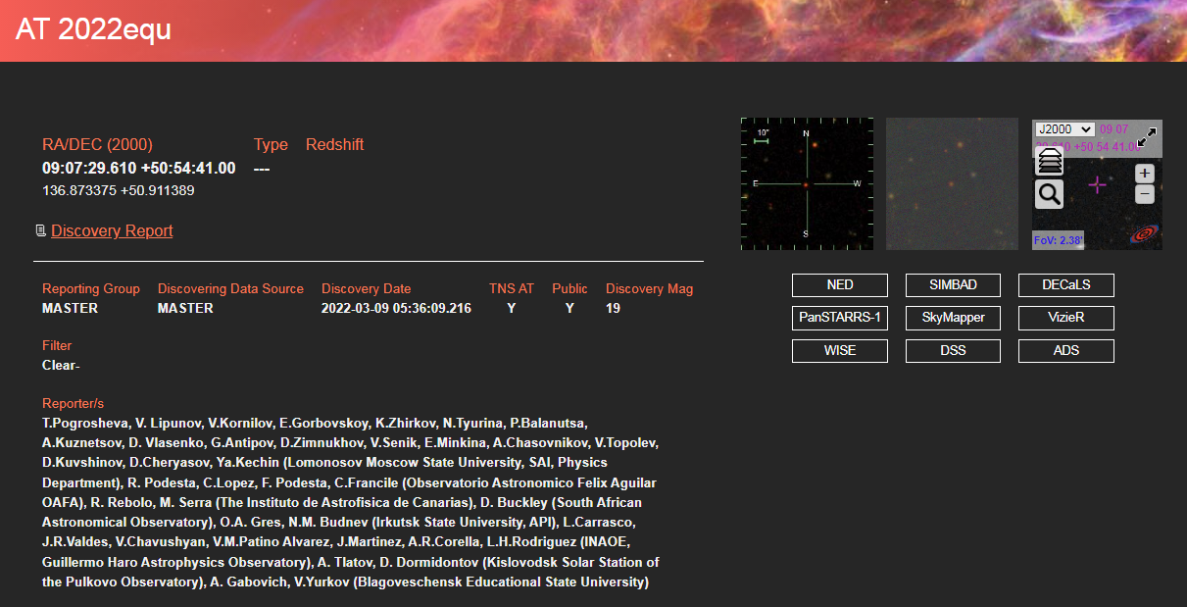
AT 2022equ
https://www.wis-tns.org/object/2022equ
RA/DEC (2000)09:07:29.610 +50:54:41.00

Slide 25

AT 2022eqv
https://www.wis-tns.org/object/2022eqv
RA/DEC (2000)09:10:56.870 +50:02:28.50

Slide 26
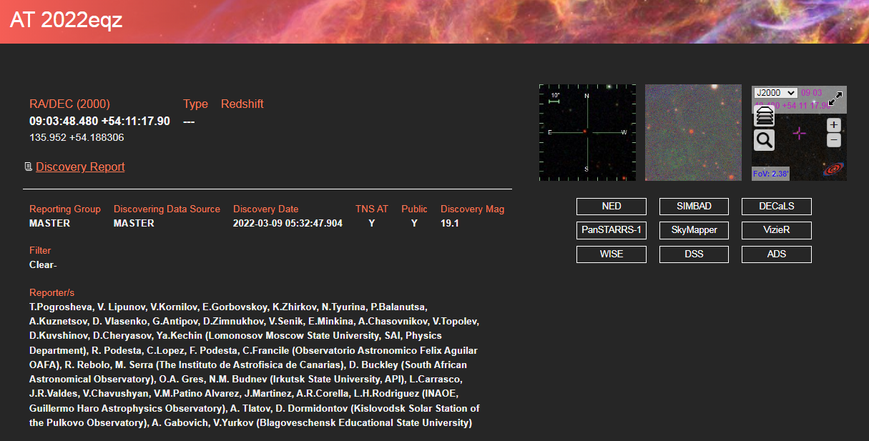
AT 2022eqz
https://www.wis-tns.org/object/2022eqz
RA/DEC (2000)09:03:48.480 +54:11:17.90

Slide 27
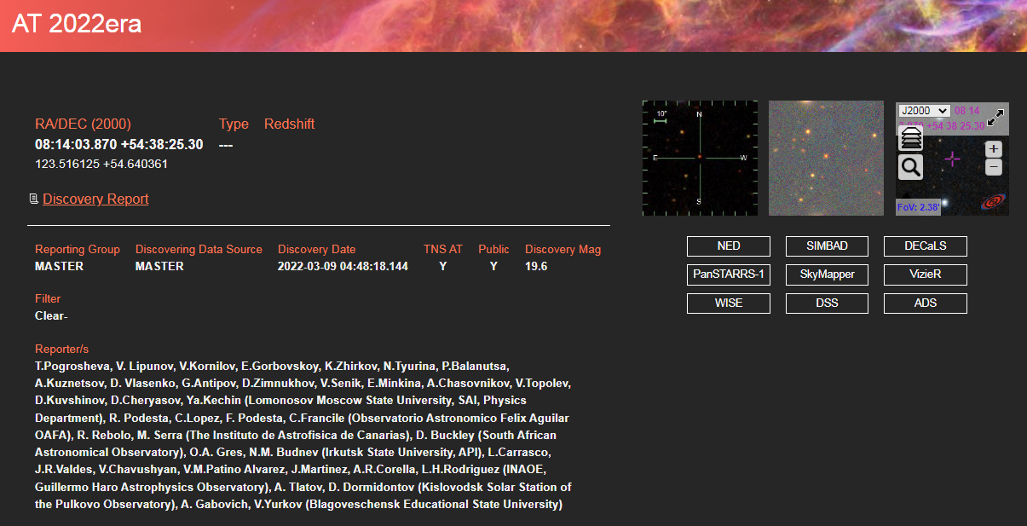
AT 2022era
https://www.wis-tns.org/object/2022era
RA/DEC (2000)08:14:03.870 +54:38:25.30

Slide 28
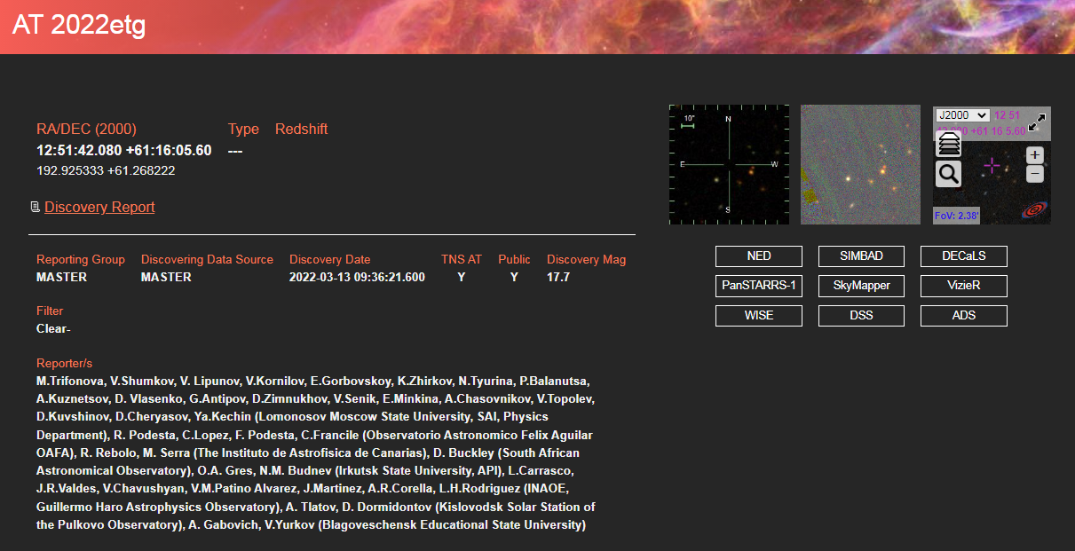
AT 2022etg
https://www.wis-tns.org/object/2022etg
RA/DEC (2000)12:51:42.080 +61:16:05.60

Slide 29
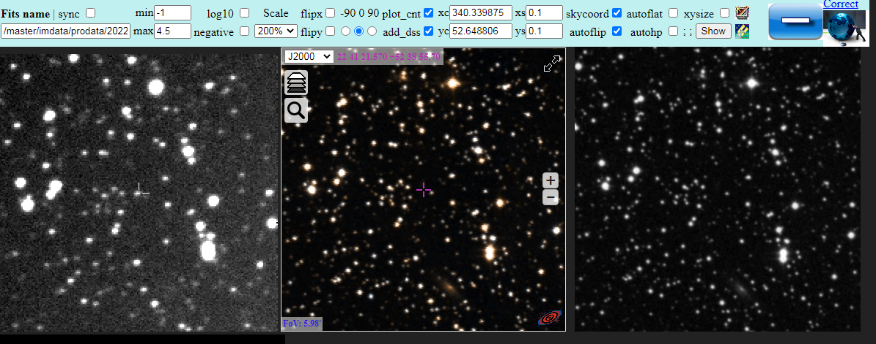
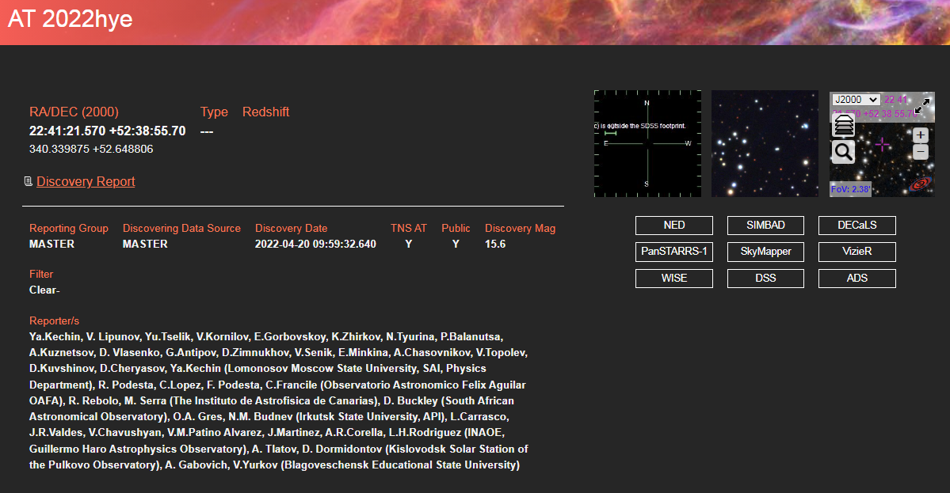
AT 2022hye

Slide 30
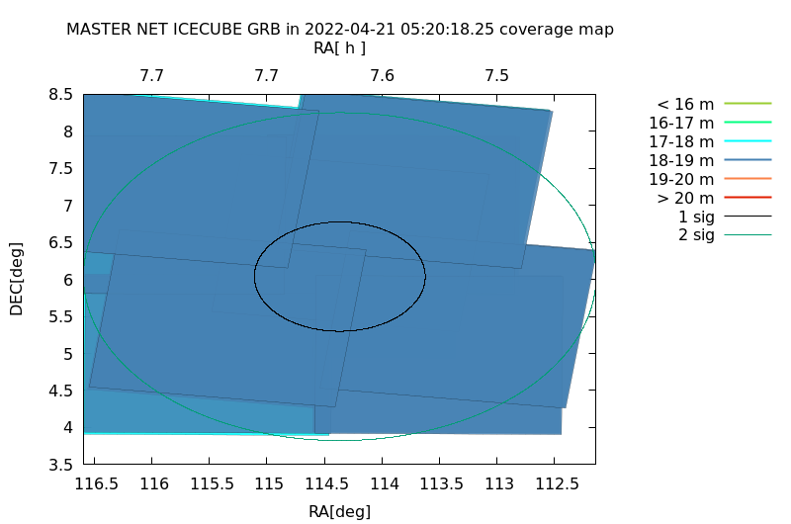
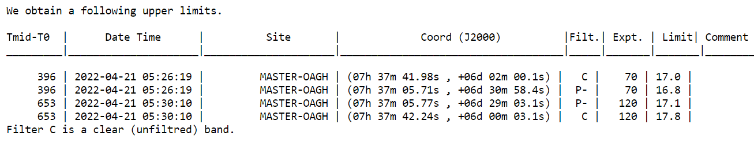
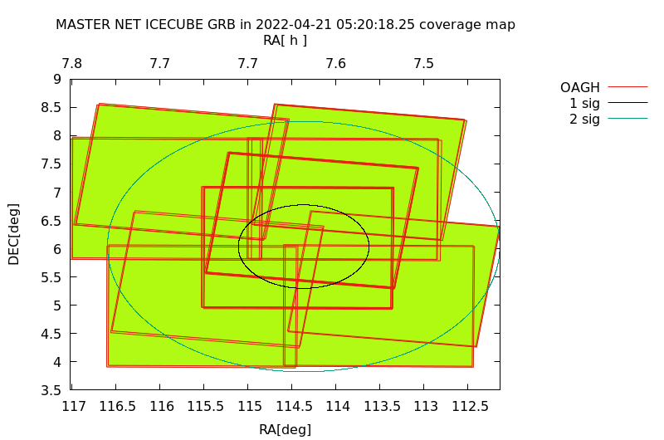
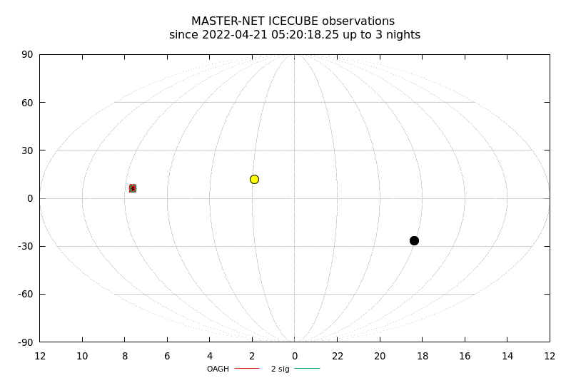
IceCube220421.22
https://gcn.gsfc.nasa.gov/gcn3/31929.gcn3

Slide 31
Результаты
Проведено более 50 наблюдений квадратов ошибок алертных событий.
Обнаружено более 20 транзиентных явлений.

Slide 32
Литература
Lipunov et al., 2010, MASTER Robotic Net, Advances in Astronomy, vol. 2010, p.30L
Lipunov et al., 2022, GCN, 31662.
Lipunov et al., 2022, GCN, 31655.
Lipunov et al., 2022, GCN, 31620.
Lipunov et al., 2022, GCN, 31614.

